Slide 1

Citi Bank – Customer Session Portal
Customer Session Portal

Slide 2
Citi Bank - CSP
Mentees:
Digvijay Singh Rathore. Purushotham Reddy Pothala. Dibakar Hazra. Sunith Kumar Patnaik. Durgam Prasanth. Ruchika AGS.
Venkata Arshitha Karodi. Nimmala Shiva Shankar. SaiKiran Achari. Madhusudhan J. Thakur Rohith Singh. Matthew Buckle A.
Mentors: Gopinath B Shashi Kumar S Koti. Binuraj E K.

Slide 3
Citi Bank – CSP – Problem Statement & Expected Outcome
Problem Statement
To build a portal which be the landing page for the customers who will be advised with the portfolio related activities from the Relationship Manager. RM should be able to manage the sessions based on the customer’s availability and requests.
Expected outcome
To build a portal to manage the customer’s sessions which can be utilized as the landing page for the customer – RM interactions.

Slide 4
Citi Bank - CSP - Technology Stack
Technology Stack:
Programming Language: Java. Framework: Spring Boot with RESTful API Tools : Postman, Soap UI, Swagger, Sonar Lint, IDE . Database: MySQL Testing: JUNIT5 Libraries: RESTful, Lombok Frontend Framework: Angular. Frontend Library: Angular Material

Slide 5
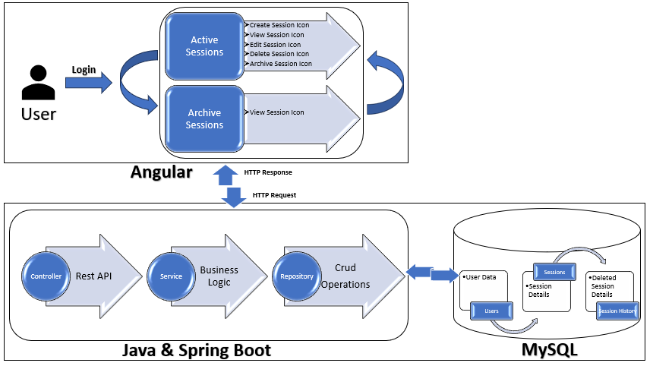
Citi Bank – CSP - Flow Diagram

Slide 6
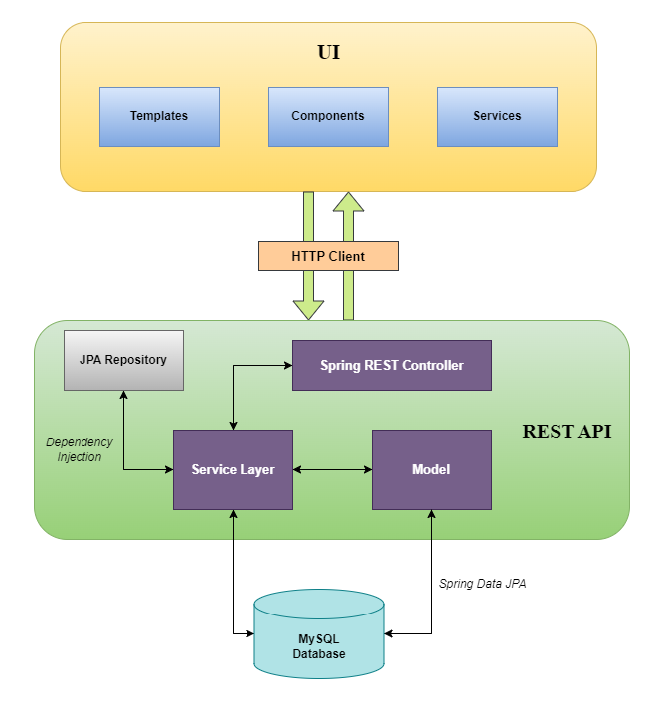
Citi Bank – CSP- Technical Architecture Diagram

Slide 7
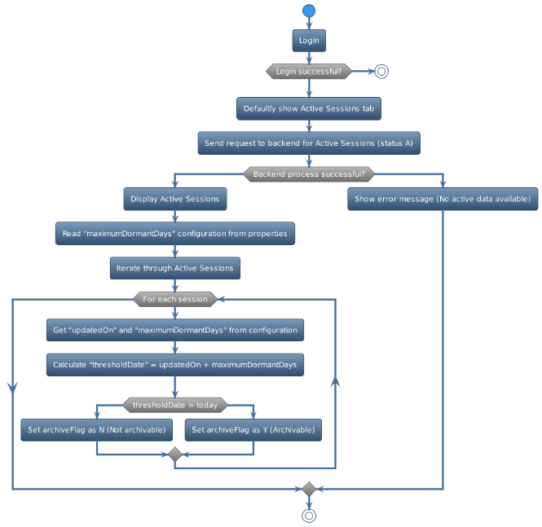
Citi Bank – CSP- Project Flow

Slide 8
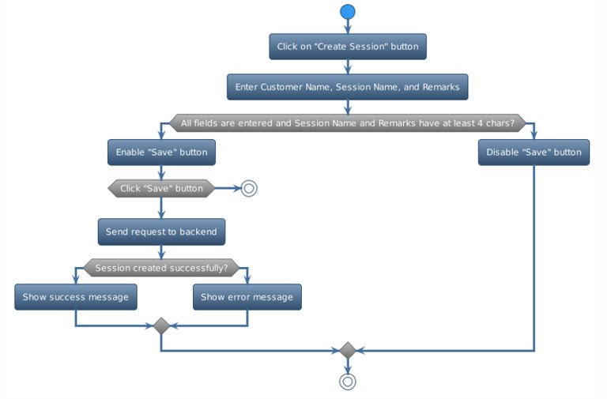
Citi Bank – CSP- Project Flow

Slide 9
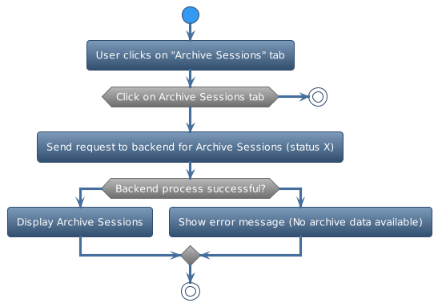
Citi Bank - CSP - Project Flow

Slide 10
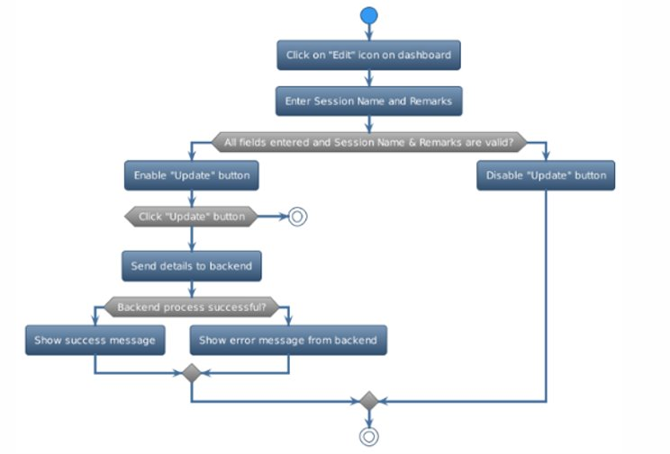
Citi Bank – CSP - Project Flow

Slide 11
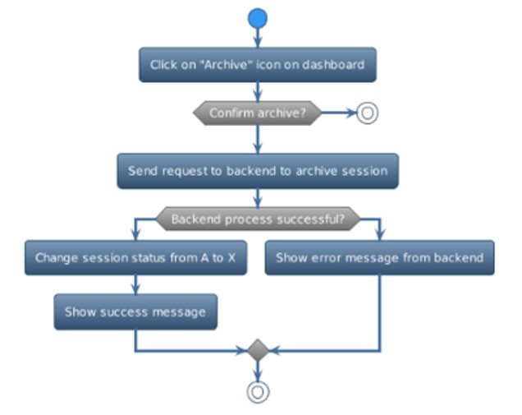
Citi Bank – CSP - Project Flow

Slide 12
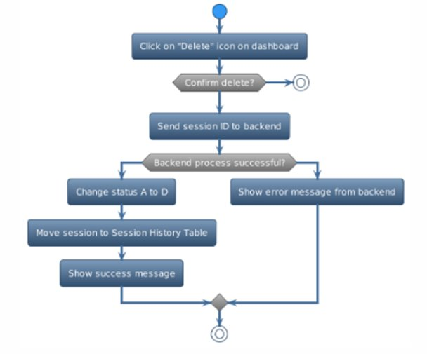
Citi Bank - CSP- Project Flow

Slide 13
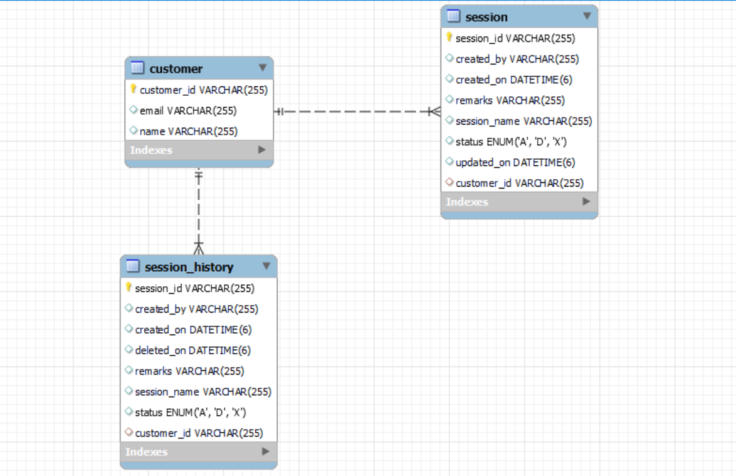
Citi Bank – CSP - ER Diagram

Slide 14
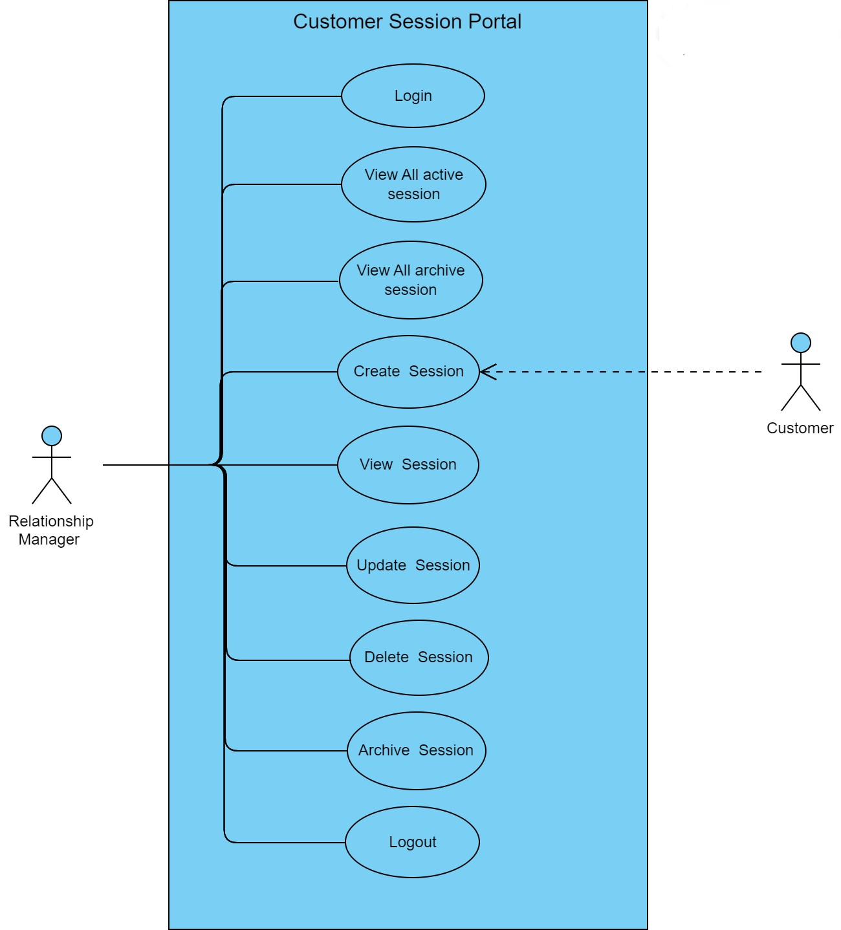
Citi Bank – CSP - Use Case Diagram

Slide 15
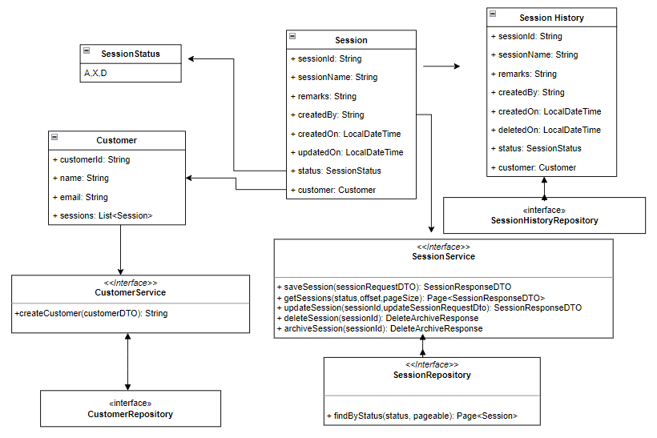
Citi Bank – CSP - Class Diagram

Slide 16
Citi Bank – CSP - Sequence Diagram
Session Management Portal Sequence Diagram.pdf

Slide 17

Citi Bank – CSP - Demo
DEMO

Slide 18

Citi Bank – CSP - Deployment

Slide 19
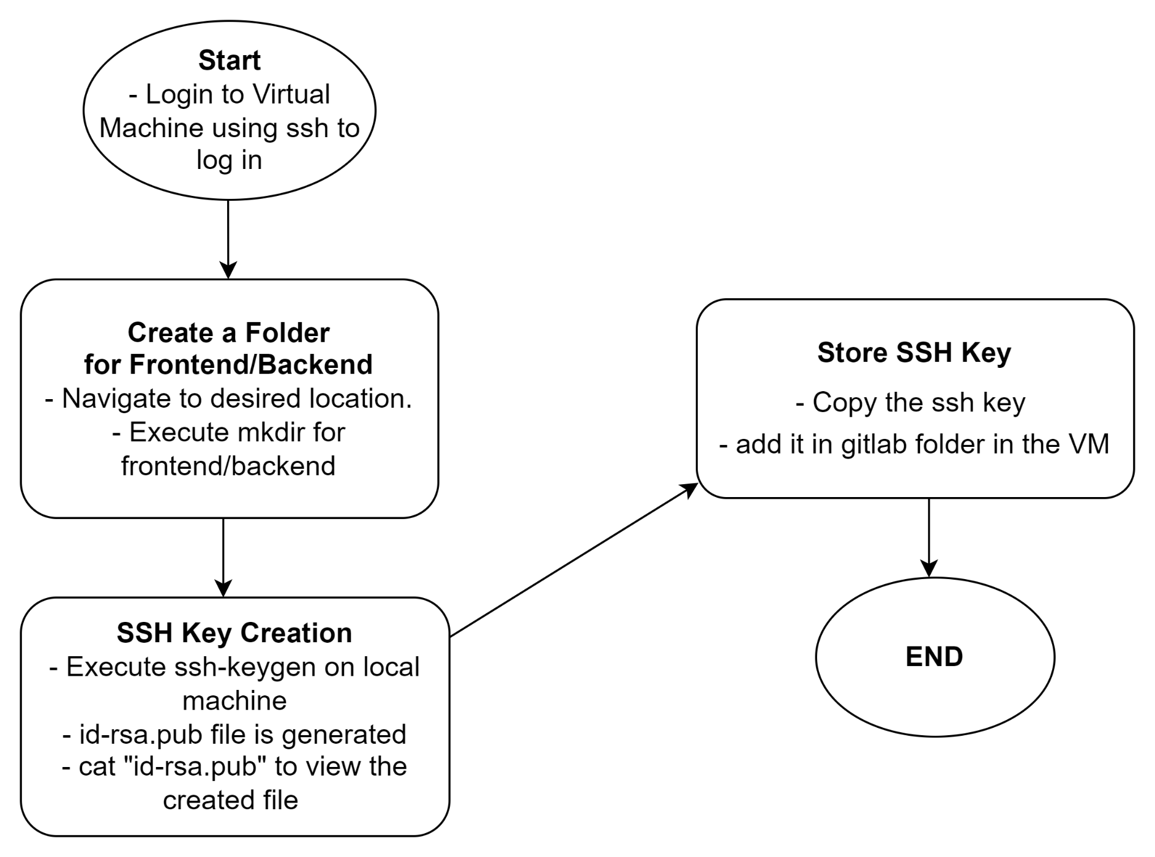
Citi Bank – CSP - SSH Creation (Deployment)

Slide 20
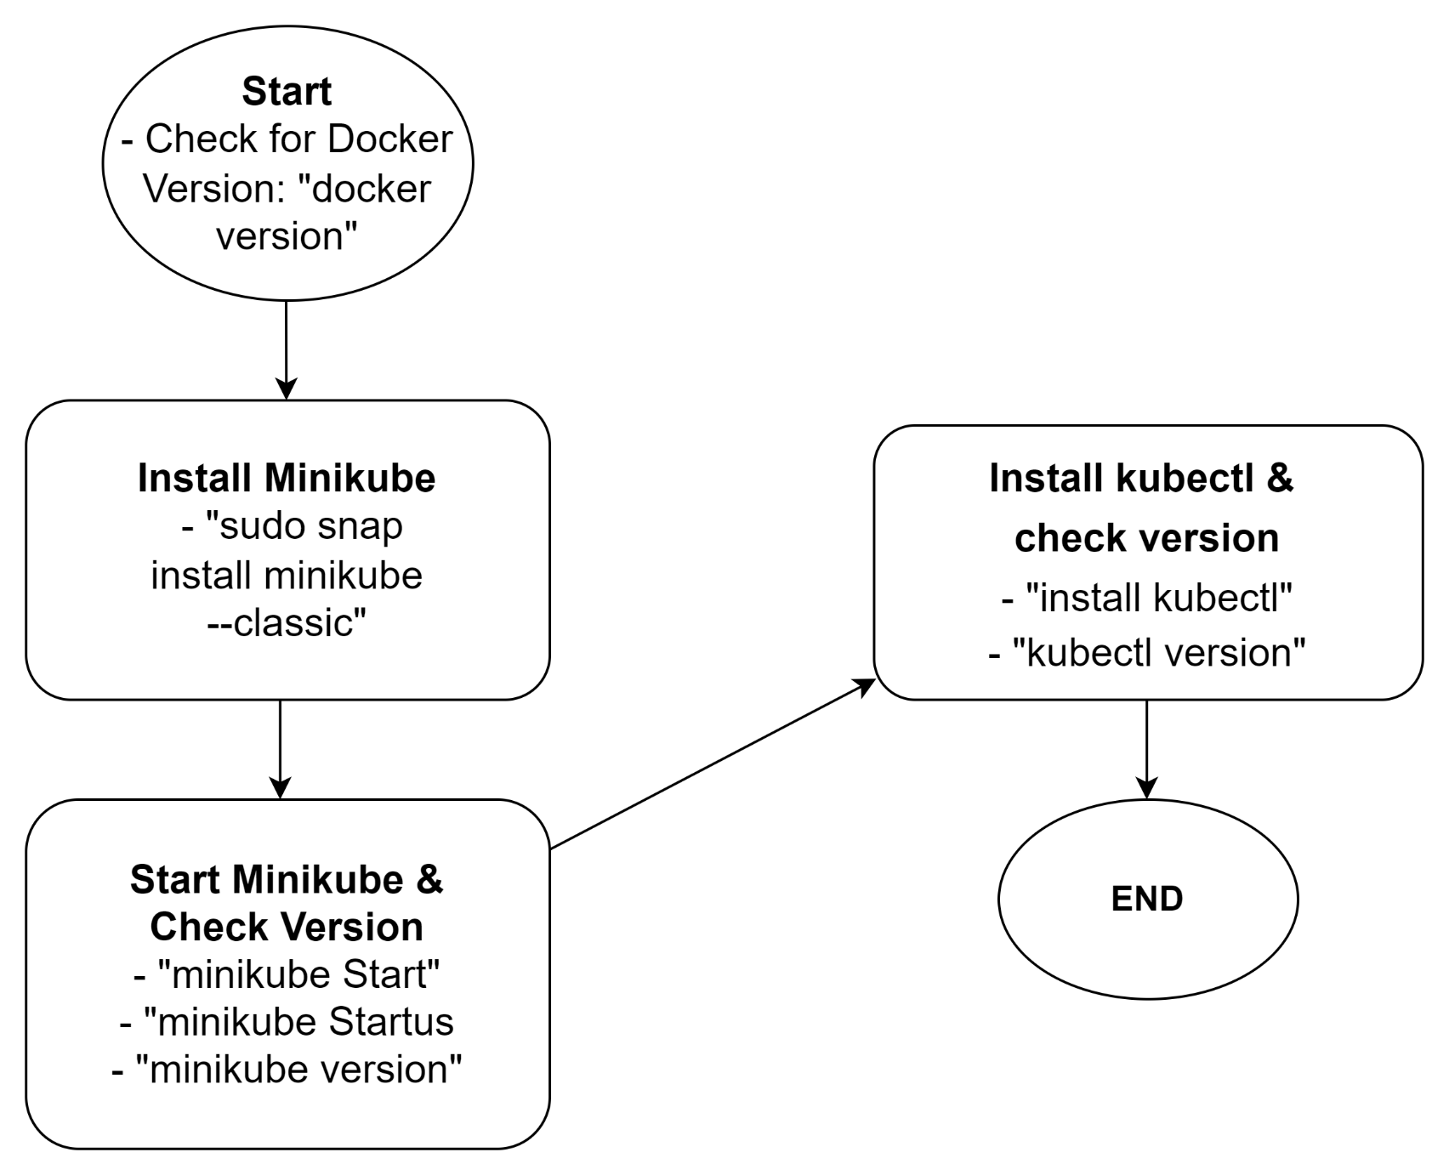
Citi Bank – CSP – Docker Setup

Slide 21
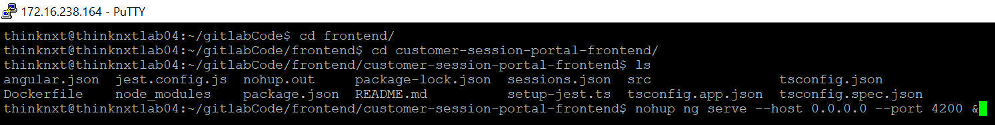
Citi Bank – CSP – Manual Deployment
Front-End: VM Deployment
Navigate to the Front-End folder where the Angular Application is present
nohup ng serve --host 0.0.0.0 --port 4200 &
“nohup” command is used to make sure the application is running in backend even if we exit from the VM
“0.0.0.0” IP is used to make sure external connections are able to access the 4200 port in VM

Slide 22
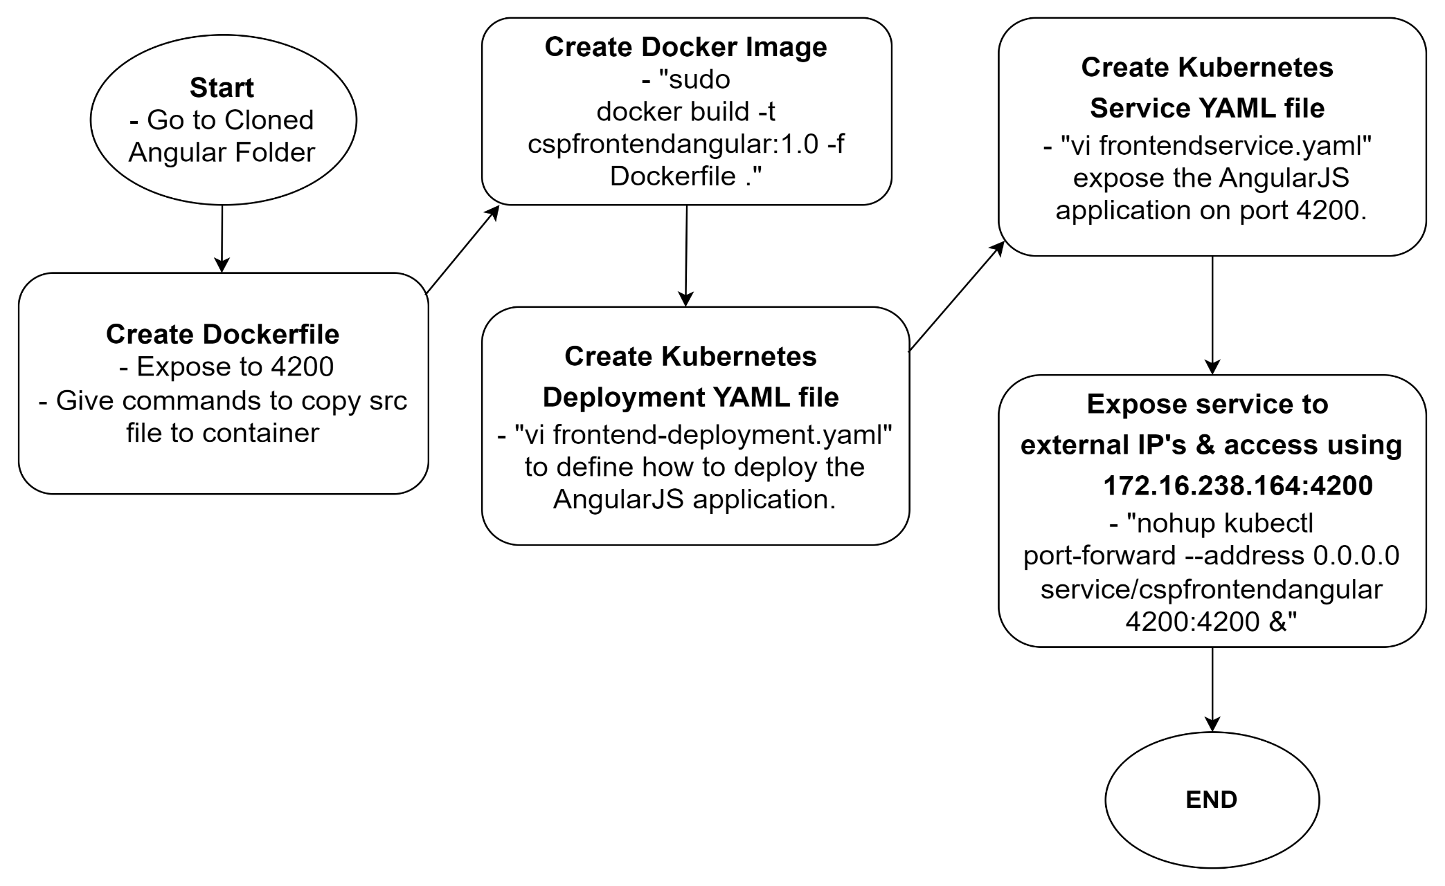
Citi Bank – CSP - Deployment
Front-End: Minikube Cluster Deployment using Docker Image

Slide 23
Citi Bank – CSP - Deployment
Back-End: Manual VM Deployment
Go to the Backend-End folder where the Java Application is present
Run this command to start the Java Application: “nohup java -jar /home/thinknxt/gitlabCode/backend/customer-session-portal-backend/target/project-charter-0.0.1-SNAPSHOT.jar &”
Navigate to “Logs” folder & Run “tail –f customer-session-portal.log” to see the running logs:

Slide 24
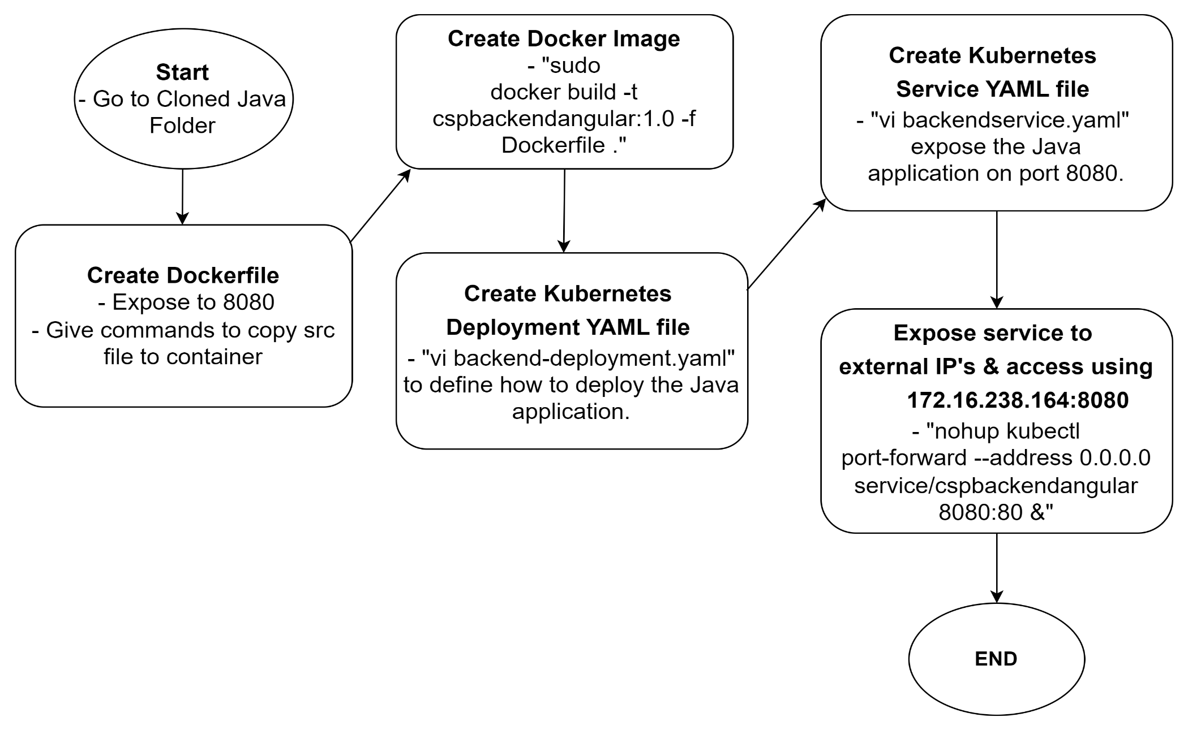
Citi Bank – CSP – Cluster Deployment
Back-End: Minikube Deployment using Docker Image

Slide 25

Citi Bank – CSP – Logging using ELK

Slide 26



Citi Bank – CSP – Logging using ELK
Elasticsearch is a NoSQL database that is based on the Lucene Search Engine which will help to store input/logs
Logstash is a log pipeline tool that accepts input/logs from various sources and exports the data to various targets
Kibana is a visualization UI layer, which helps developer to monitor application logs

Slide 27
Citi Bank – CSP – Logging using ELK
ELK is free and opensource.
Install the application in Virtual Machine / Local.
Edit the yaml file to specify the configuration.
Run the application using “systemctl start” command, each application will be starting in different port.
By default, Elasticsearch will be started in port 9200, Kibana in port 5601, Logstash in port 9600.
Verify the application is started using “systemctl status” command.
Create a logstash.conf file to accept logs from the Spring Boot Application and send to Elasticsearch.
Run the configuration file using “logstash –f logstash.conf” command.
Hit the Kibana using the URL http://172.16.238.164:5601/.
Create an index pattern in Kibana to view the application logs.

Slide 28
Citi Bank – CSP– Logging using ELK
logstash.conf
input {
file {
path => "/home/thinknxt/gitlabCode/backend/customer-session-portal-backend/target/podslog.log"
start_position => "beginning"
}
}
output {
elasticsearch {
hosts => ["http://172.16.238.164:9200"]
index => "customer_session_portal"
}
}

Slide 29
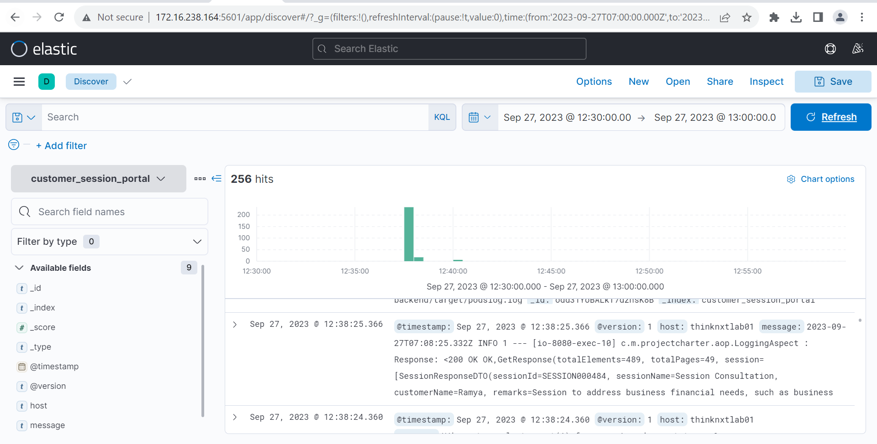
Citi Bank – CSP – Logging using ELK

Slide 30
Citi Bank – CSP – Project Activities
Project Activities :
Requirement Gathering: As mentees, we actively engaged with our mentors to gain a deep understanding of the project requirements. We meticulously evaluated the potential business impact these requirements could have. Subsequently, we crafted a comprehensive estimate plan for the deliverables, taking into account various factors and constraints. With a strong commitment to meeting deadlines, we successfully executed the plan and completed all tasks within the stipulated timeline. Prepare the project environment and collaborate with design and testing teams. Understand functionality, Business logic and design. Design plan approval. Create comprehensive test cases. Set up development environment. Install necessary tools (IDEs, DB, Postman, Sonar Lint, Postman, Soap UI, Vs code ). Design database tables. UI-specific prerequisites. Backend: Created APIs for session management (create, update, delete, archive).

Slide 31
Citi Bank – CSP – Project Activities
Project Activities :
Frontend: Developed login page, dashboard, session management (create, view, delete, update ,archive ), and pop-ups. In Integration Phase : Divided into 4 groups (1 frontend, 2 backend). Achievements: Successfully completed integration within the given time frame. Deployment: Created Docker File and deployed as a container. Coding Standards: Followed Java 8 for backend and Angular 15 for frontend. Code Analysis: Used EsLint for frontend and Sonar Lint for backend. Frontend Enhancements: Integrated Angular Material. Added Bootstrap to the application. Feedback: Received positive feedback from mentor on coding standards, performance, and API response time (below 500 ms). Our collaborative effort and dedication ensured the project's smooth progression and timely completion.

Slide 32
Citi Bank – CSP - Challenges and Solution
Challenges : Complex Data Model Design : Designing a data model that accurately captures customer session data, including various attributes and relationships, was challenging. It required careful consideration of database schema design. Performance Optimization : For the portal delivered a fast and responsive user experience, even with a large amount of data, presented performance optimization challenges. Solutions : Complex Data Model Design : We conducted extensive data modeling sessions with mentors to identify the most essential data entities and their relationships. We implemented advanced database design techniques such as normalization to ensure efficient data storage and retrieval. Performance Optimization : We conducted performance profiling and identified bottlenecks in the application. Several optimizations were made, including database query optimization, caching frequently accessed data, and implementing lazy loading for data retrieval. Load testing was performed to validate the improvements and ensure the system could handle concurrent users efficiently.

Slide 33
Citi Bank – CSP - Future Improvements
Implement JWT login authentication and authorization to enhance security and user experience. Embrace microservices architecture for scalability, flexibility, and better management of portal functionalities. Continuously focus on performance optimization and user-centric improvements to stay ahead of evolving customer needs and technological advancements.

Slide 34
Citi Bank – CSP - Documents
Customer Session Portal Load testing.pdf Software Requirements Specifications.docx (sharepoint.com) CSP-User Manual.pdf

Slide 35
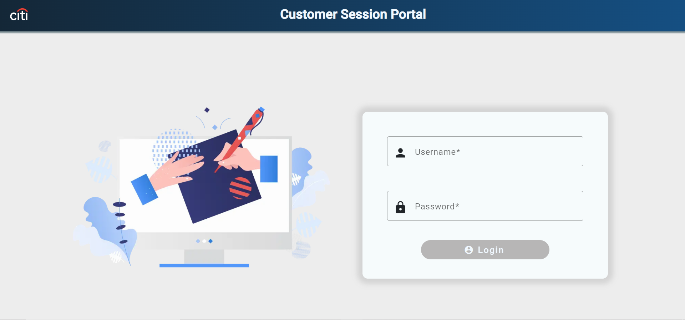
Citi Bank – CSP- Login Page
Portal Pages
LOGIN PAGE
RM login page with authentication.
RM login with password.
Display RM username on successful login.

Slide 36
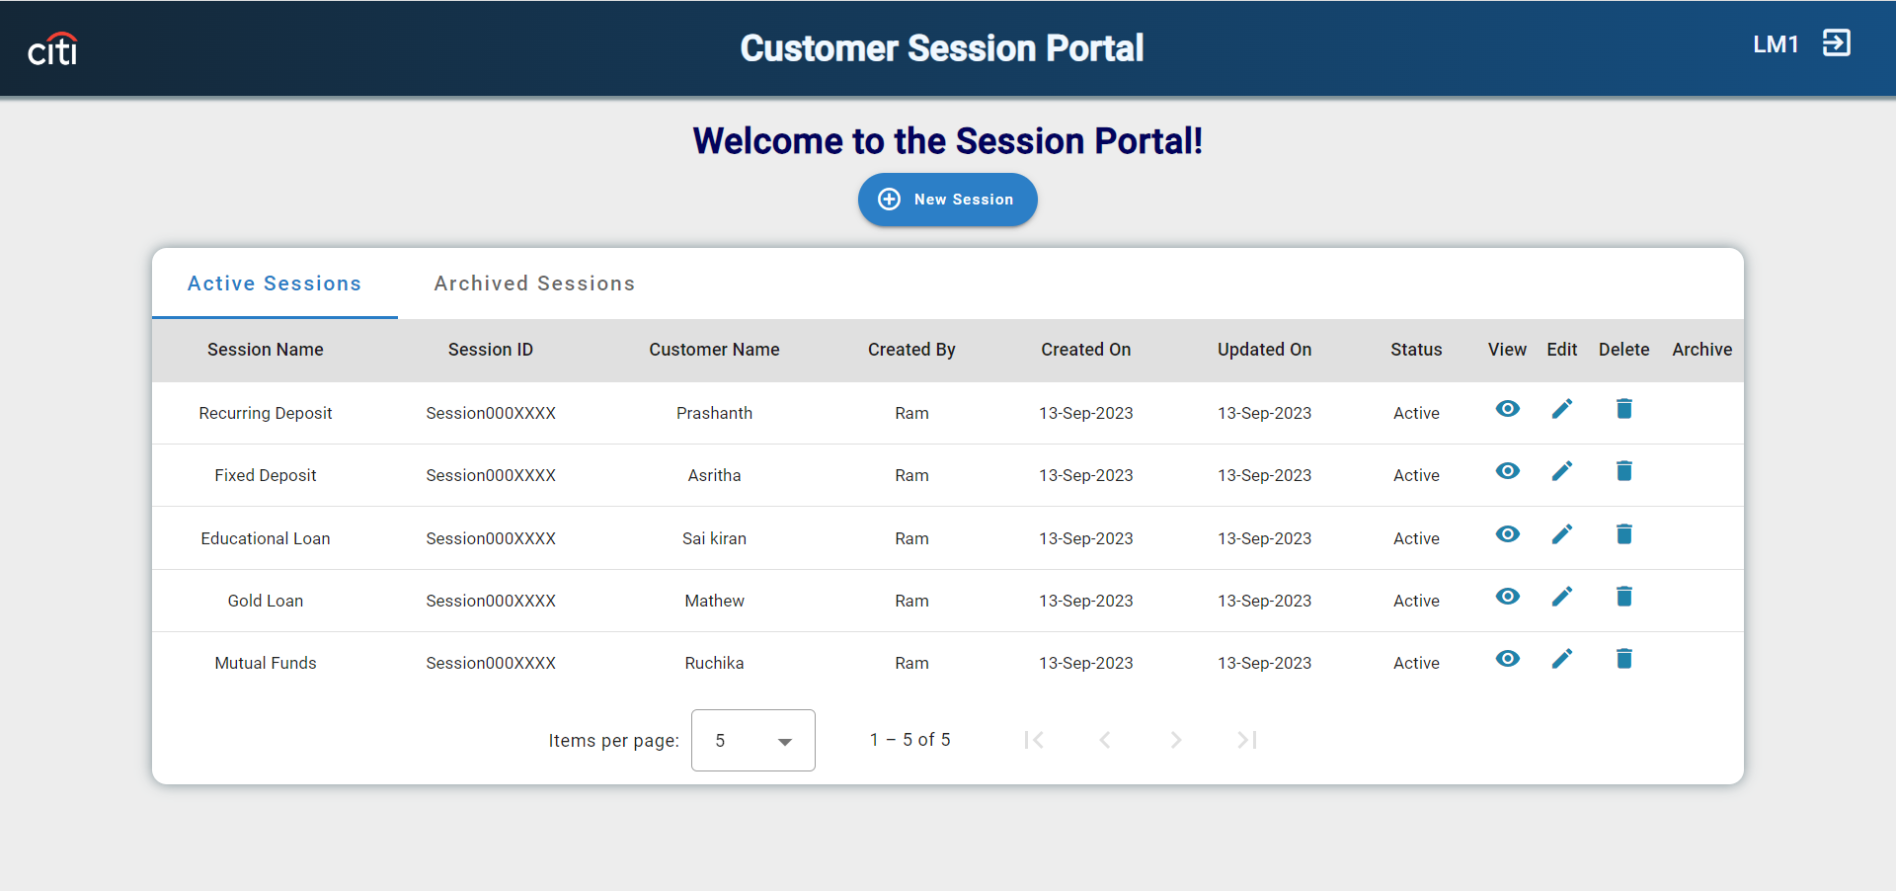
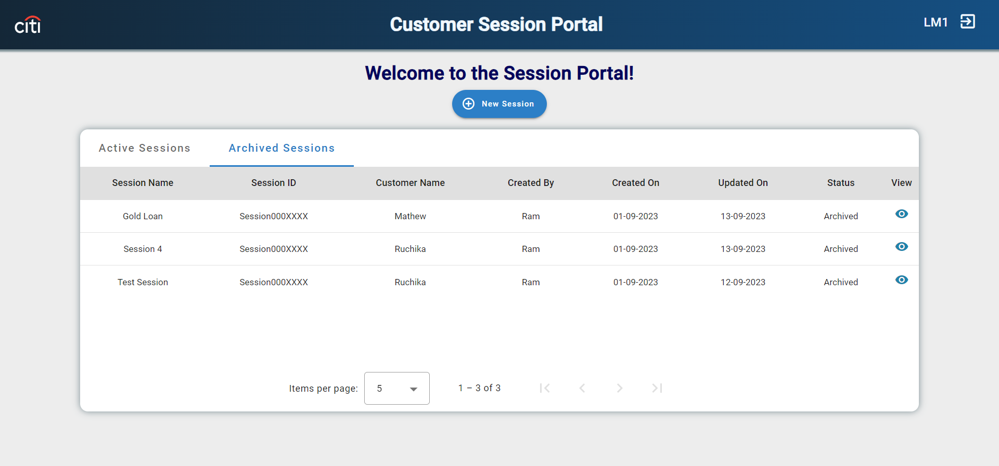
Citi Bank – CSP – Dashboard Page
Dashboard Page. Central hub for managing customer sessions. Tabs : Active and Archive. Archive Functionality: It will be enabled once the last updated date duration is 10 days before the current date.

Slide 37
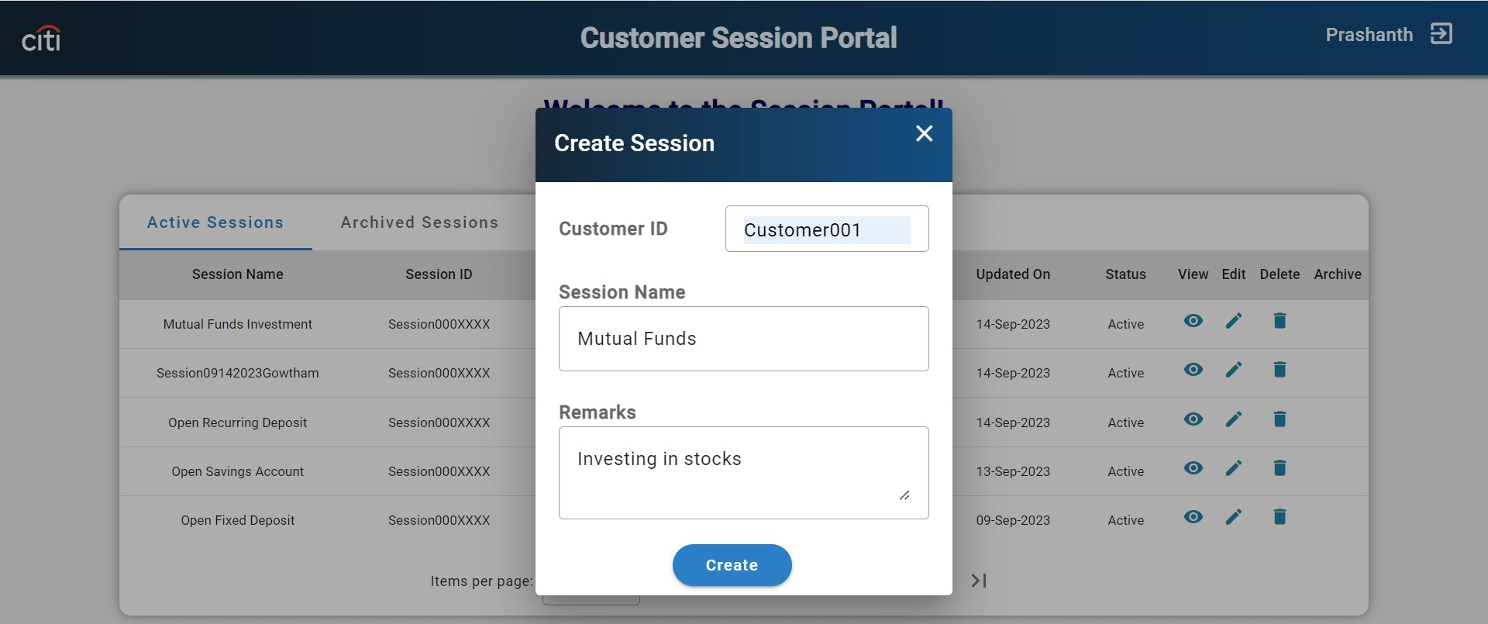
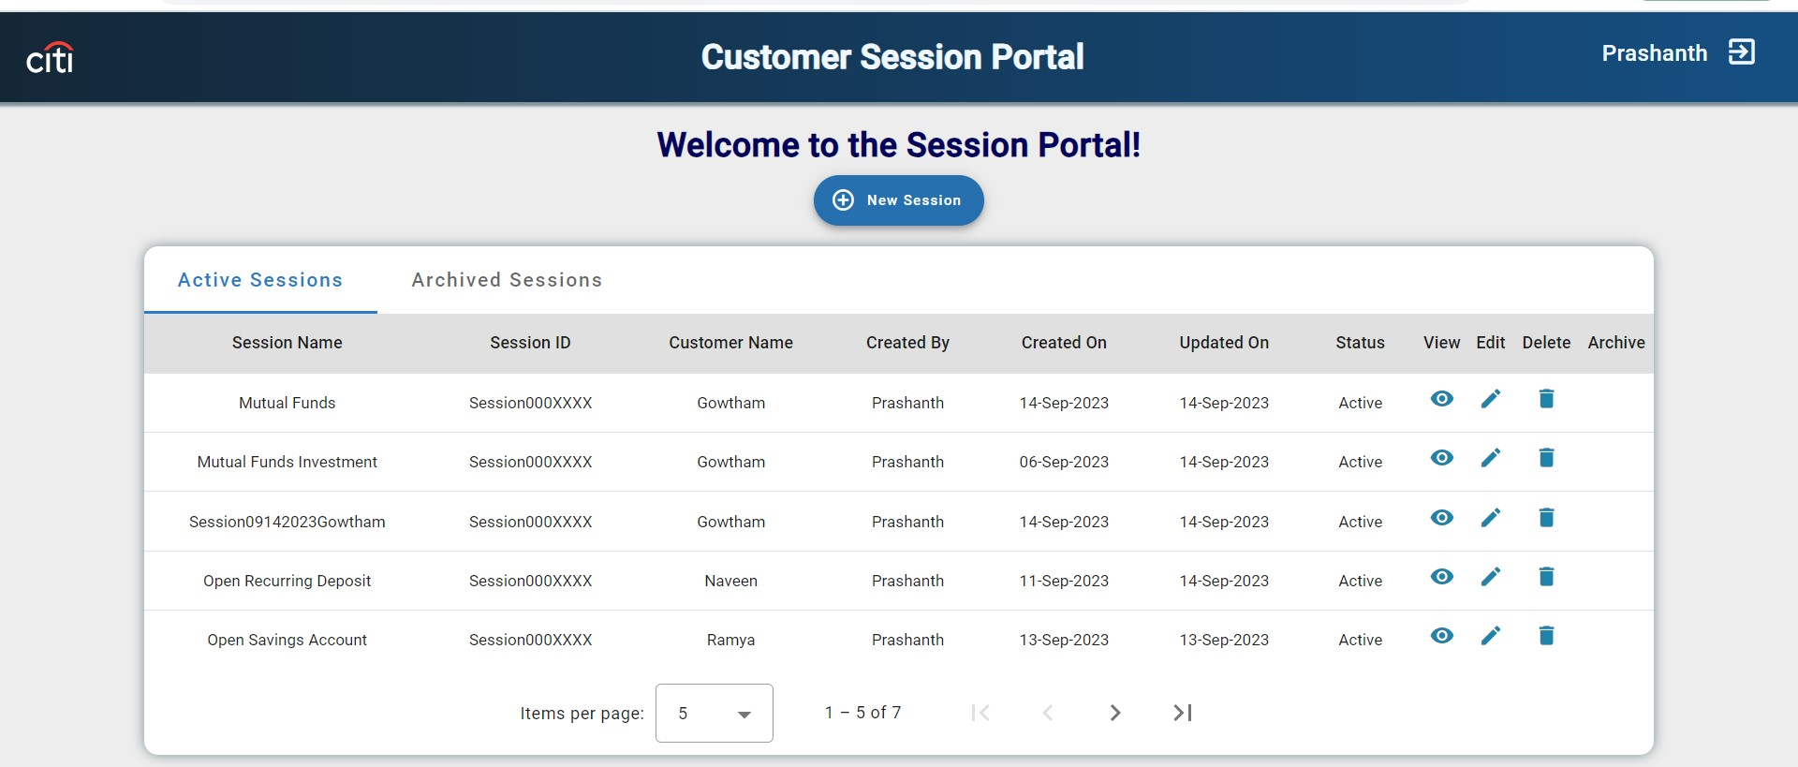
Citi Bank – CSP – Create Session
Create Session Create Functionality : On Click of New Session it will display one Dialog box to create a session.

Slide 38
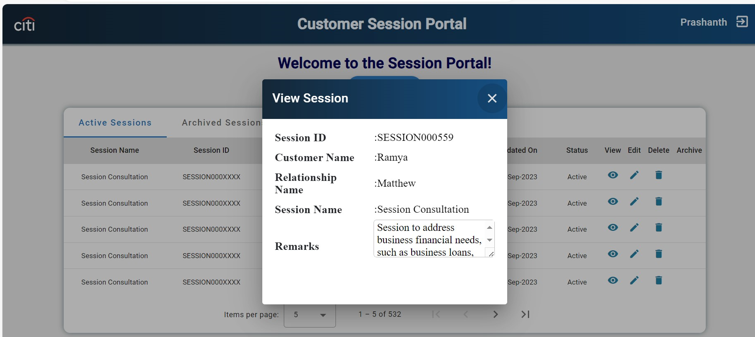
Citi Bank – CSP - View Session
View Session View Functionality : On Click of view icon it will display information about specific session.

Slide 39
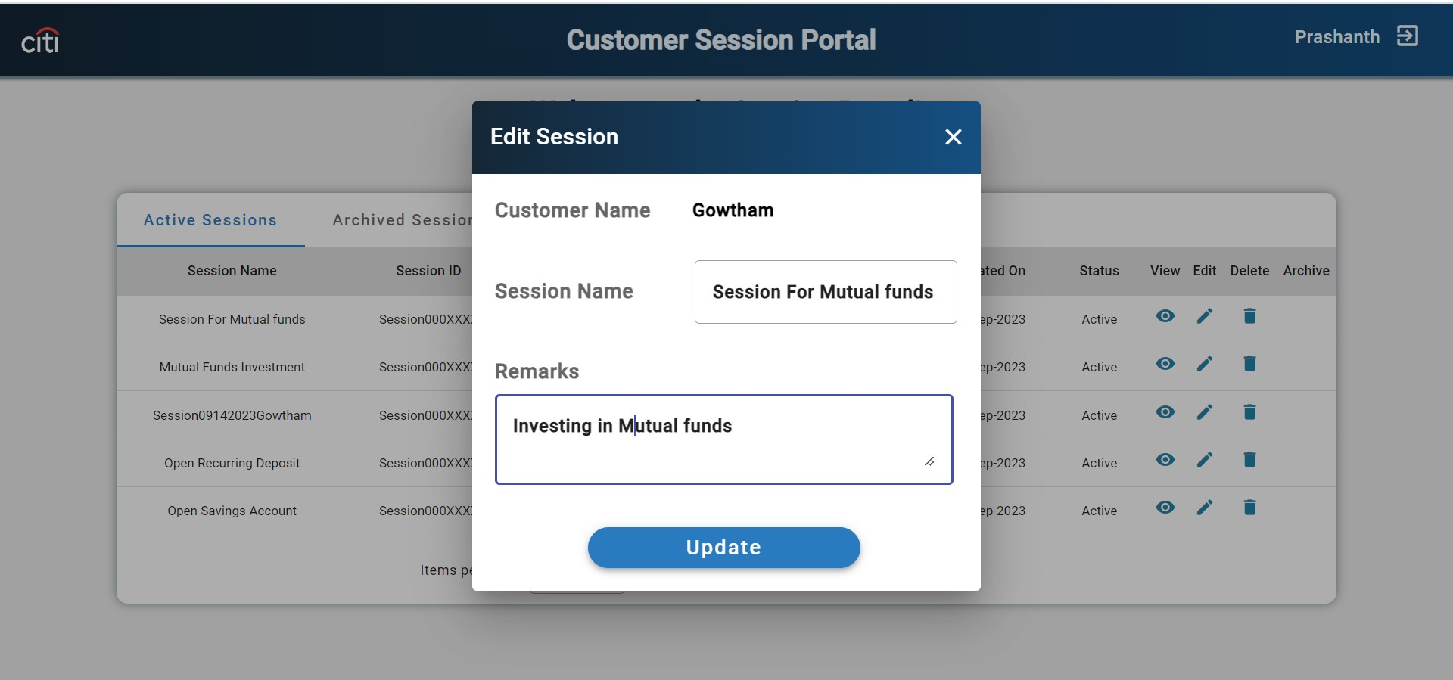
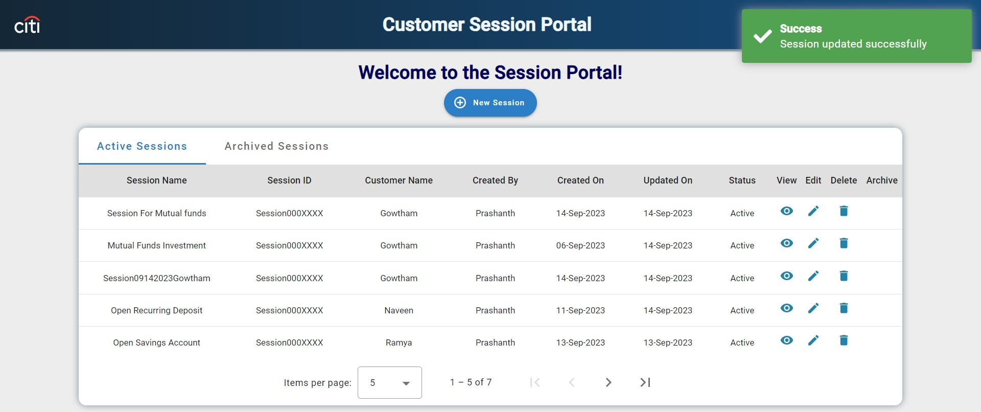
Citi Bank – CSP - Edit Session
Edit Session Edit Functionality :On Click of edit icon it will display a dialog to edit the session.

Slide 40
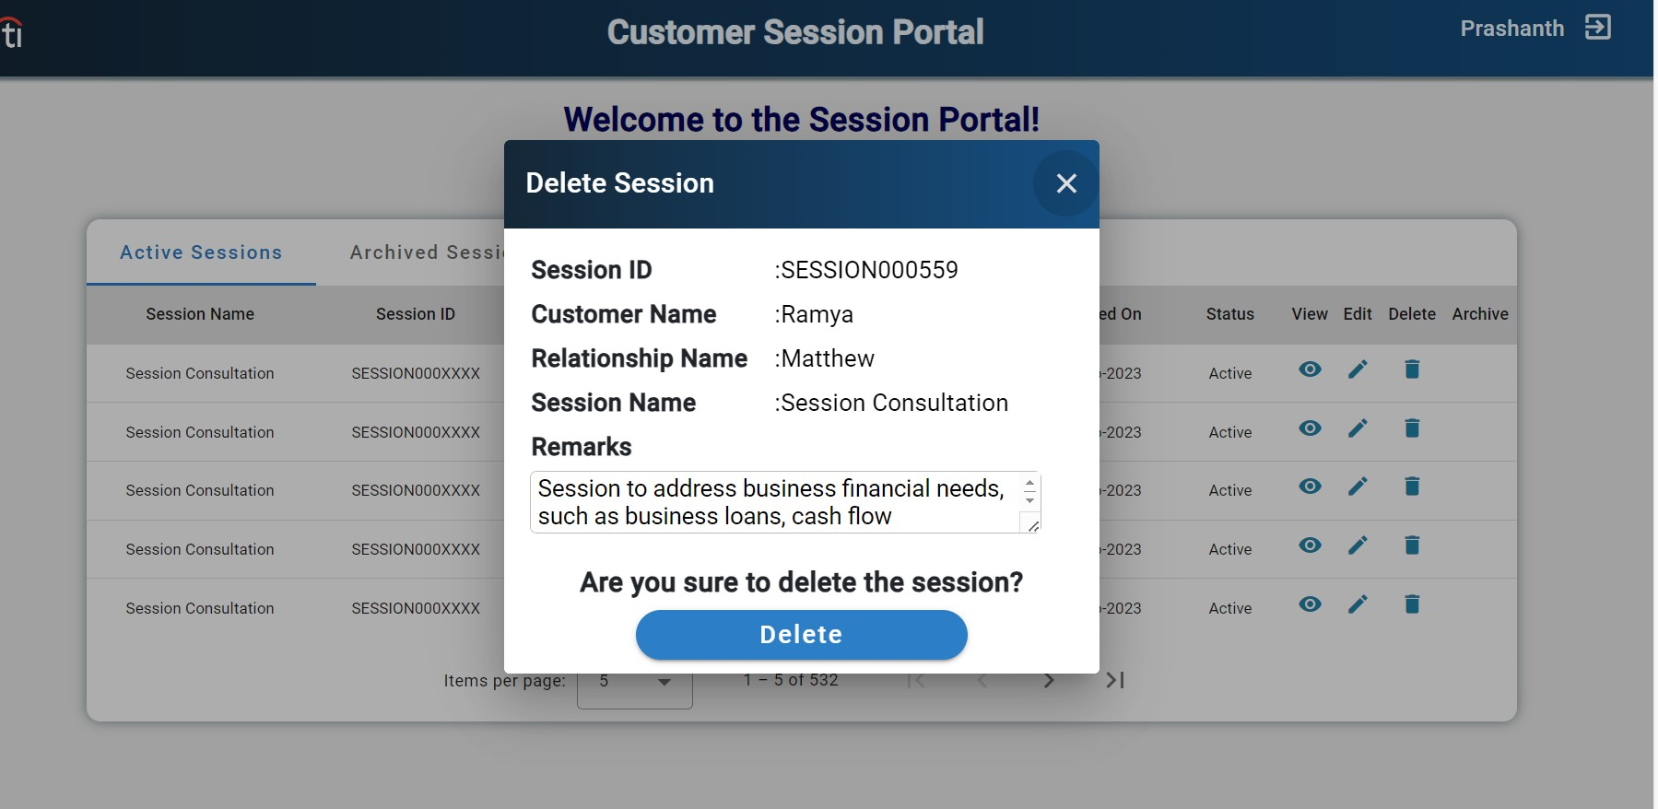
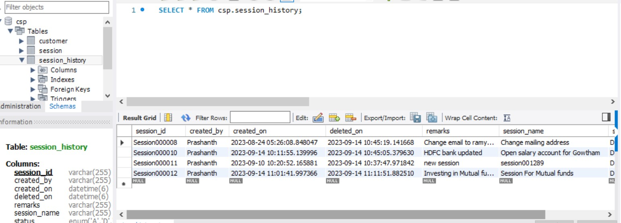
Citi Bank – CSP - Delete Session
Delete Session Delete Functionality: On Click of delete icon it will change the status of session from active to delete and store the same record in session history table.

Slide 41
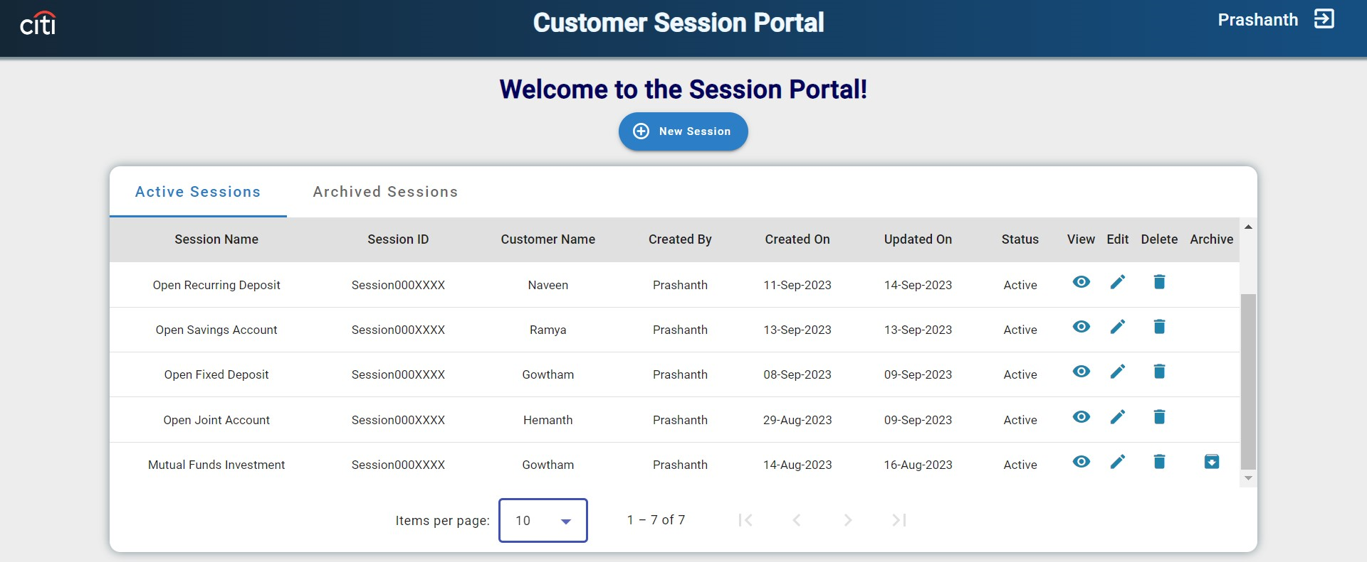
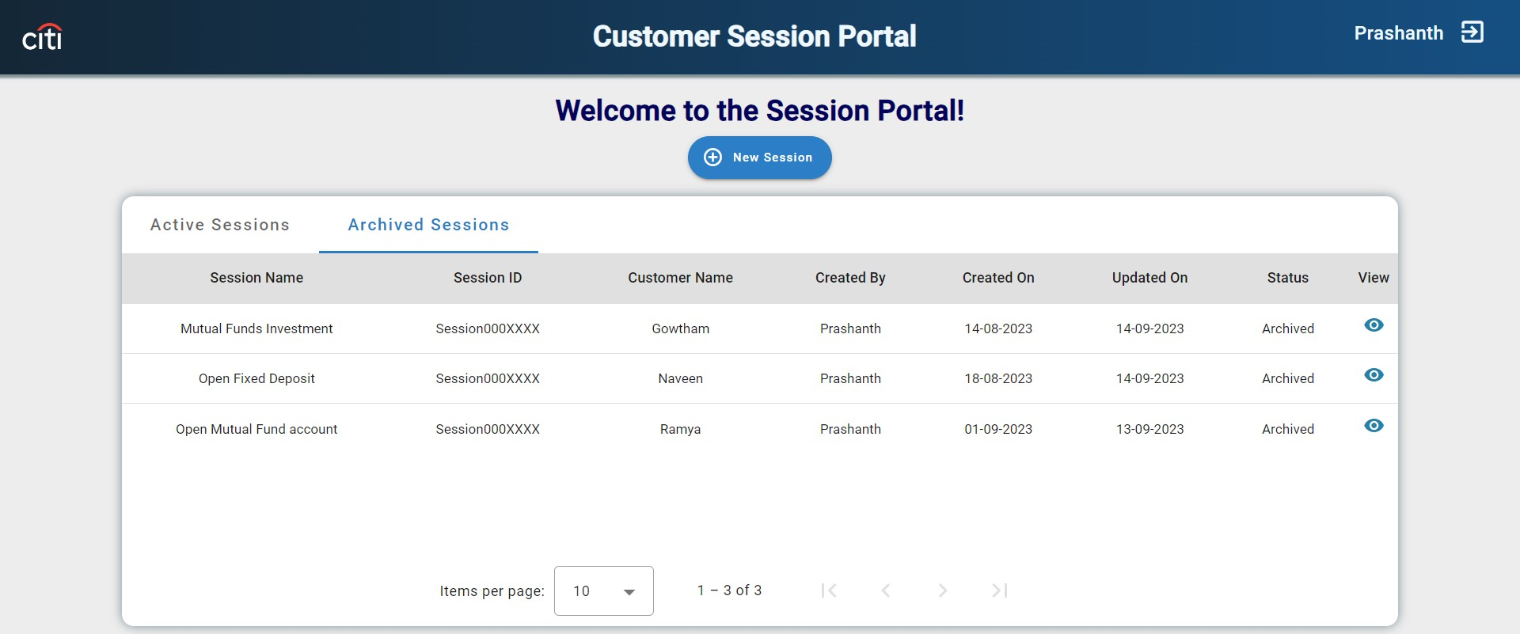
Citi Bank – CSP – Archive Session
Archive Session Archive functionality : If the difference between the updated date and current date is more than 10 days, then the session is eligible to archive.

Slide 42
Citi Bank- CSP - Question And Answer
Q & A

Slide 43


